Slide 1


Hotel Aggregator Analysis
Tableau Project

Slide 2

This internship project aims to analyze a dataset of hotel aggregator listings using Power BI/Tableau.
Objective
The dataset comprises various attributes related to listings, hosts, reviews, and availability.
The objective is to create comprehensive visualizations and insights that shed light on trends, patterns, and factors influencing listings’ performance.
Through Power BI/Tableau, interns will explore key metrics such as pricing, availability, host characteristics, and review scores to derive actionable insights for improving the overall quality and competitiveness of the listings.
Neil Armstrong

Slide 3


Dataset Description
id: Unique identifier for each listing.
listing_url: URL of the listing on the hotel aggregator platform.
scrape_id: Identifier for the data scraping event.
last_scraped: Date of the last data scrape.
source: Source of the listing information.
name: Name of the listing.
description: Description of the listing.
neighborhood_overview: Overview of the neighborhood where the listing is located.
picture_url: URL of the listing's picture.
host_id: Unique identifier for the host.
... (and many more columns capturing details about hosts, location, property type, room details, amenities, pricing, availability, reviews, and other relevant information)

Slide 4


Project Objectives (Part-1)
1. Geographical Insights:
- Visualize the distribution of listings on a map to identify popular neighborhoods.
- Explore the geographical concentration of listings and host locations.
2. Pricing and Availability Analysis:
- Analyze pricing trends based on property types, room types, and accommodation capacity.
- Investigate the availability of listings over time and identify peak periods.
3. Host Performance:
- Evaluate host characteristics, including superhost status, response times, and verification methods.
- Explore correlations between host attributes and listing performance.

Slide 5


Project Objectives (Part-2)
4. Review Scores and Guest Satisfaction:
- Examine review scores and their impact on overall listing performance.
- Identify areas for improvement based on specific review categories.
5. Property Type and Room Analysis:
- Analyze the distribution of property types and room types.
- Explore trends in the popularity of specific accommodation setups.

Slide 6
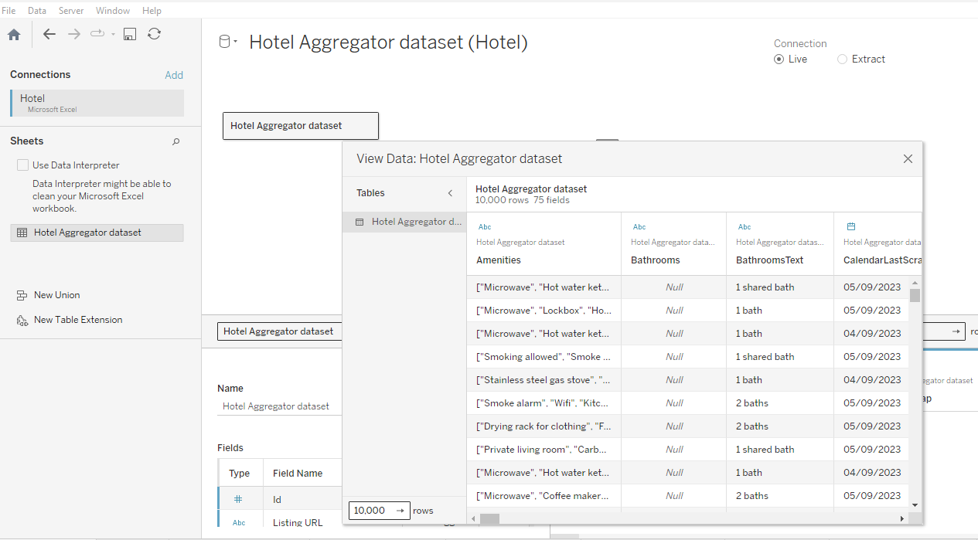
Data Source
Hotel Aggregator Dataset
A data source being loaded in Tableau

Slide 7
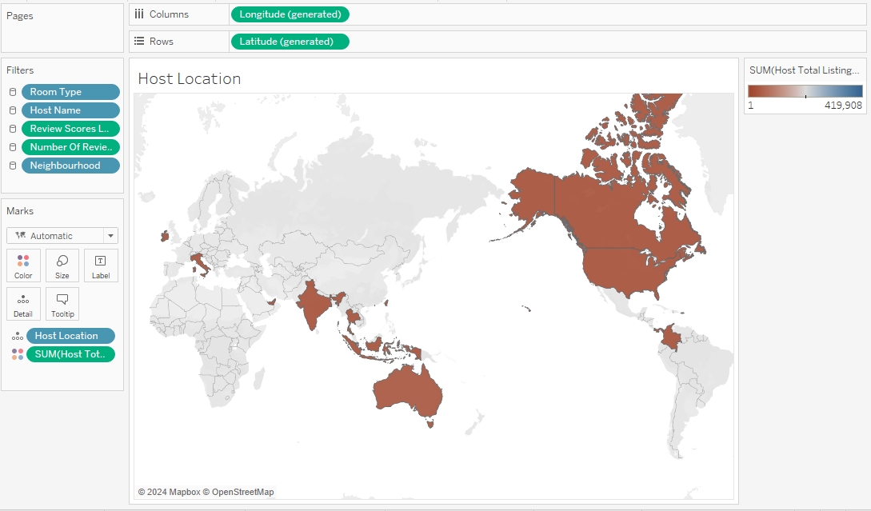
Geographic Insights
Explore the geographical concentration of listings and host locations.
We are finding the host location for the given data set.

Slide 8
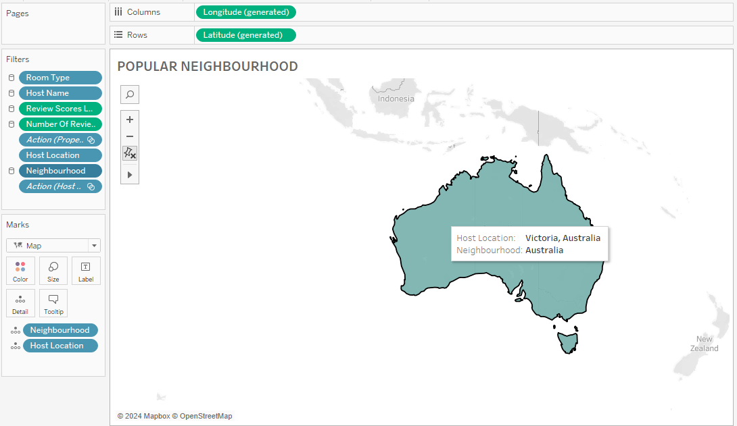
Geographic Insights
Visualize the distribution of listings on a map to identify popular neighborhoods.
Identifying popular Neighbourhoods

Slide 9
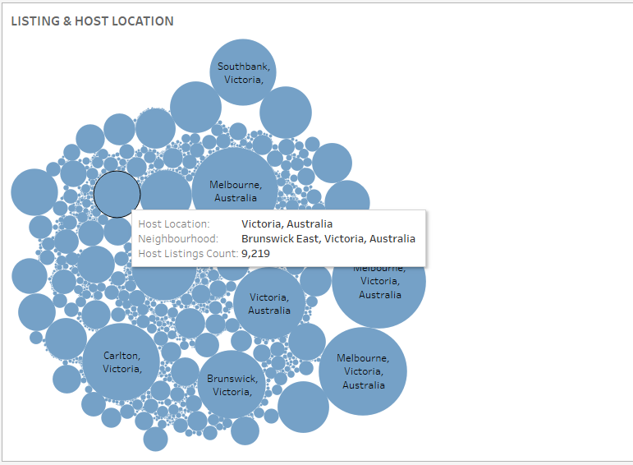
Geographic Insights
Visualize the distribution of listings on a map to identify popular neighborhoods.
Details on Popular neighbourhoods

Slide 10
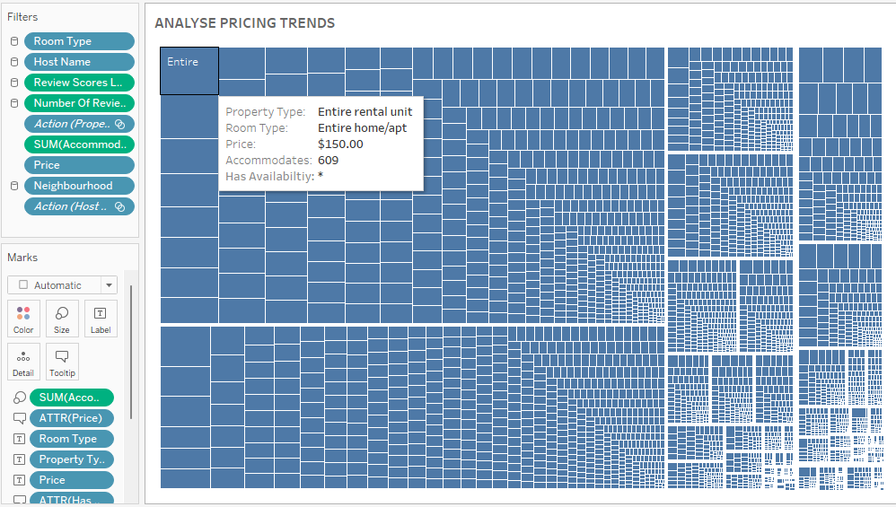
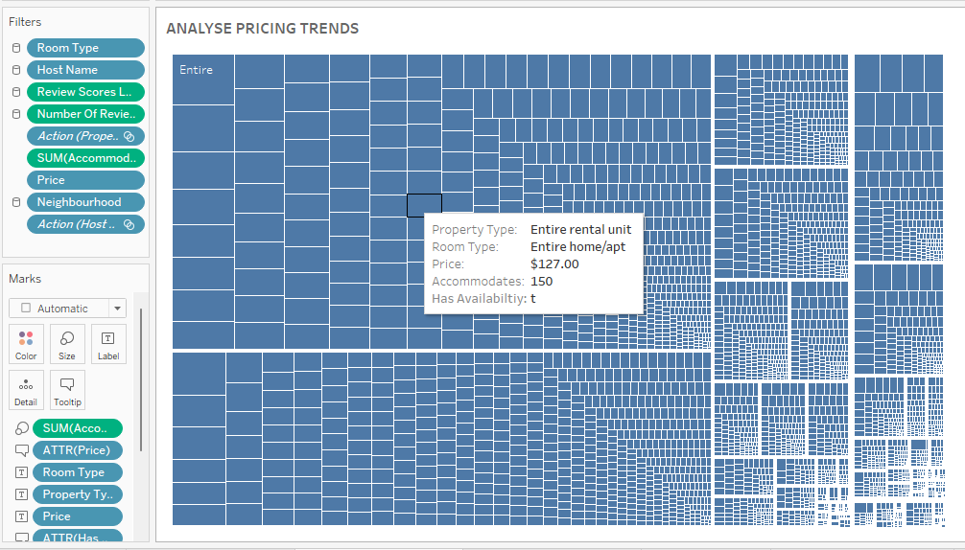
Analyze pricing trends based on property types, room types, and accommodation capacity.
Pricing and Availability Analysis:
Analyzing Pricing trends with property types, Room Types, Prices, accommodations, and availability. Where ‘t’ is true for availability and ‘*’ is false

Slide 11
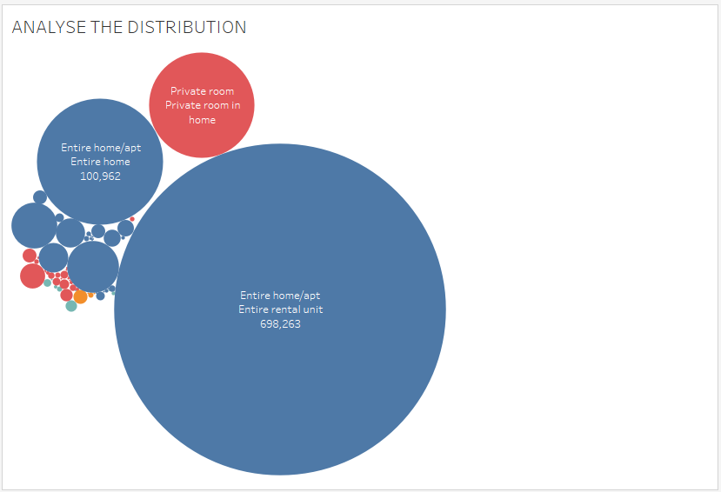
Investigate the availability of listings over time and identify peak periods.
Pricing and Availability Analysis:

Slide 12
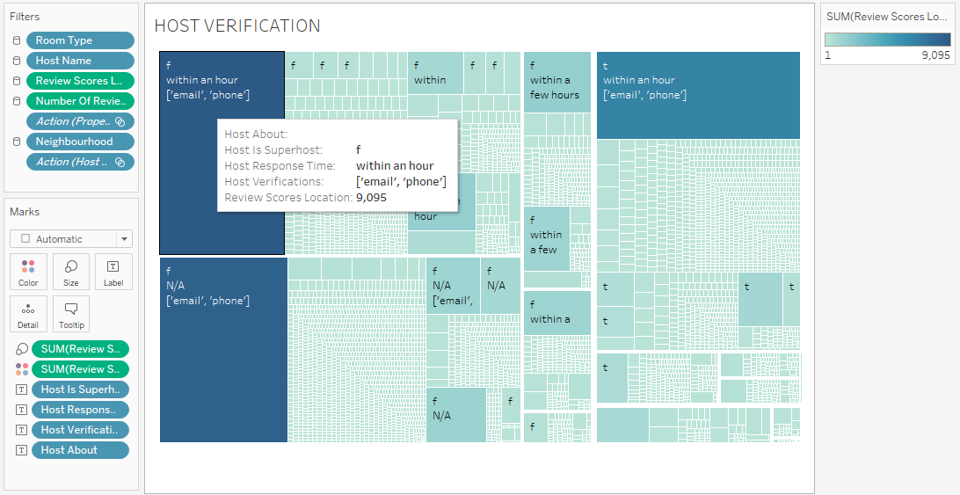
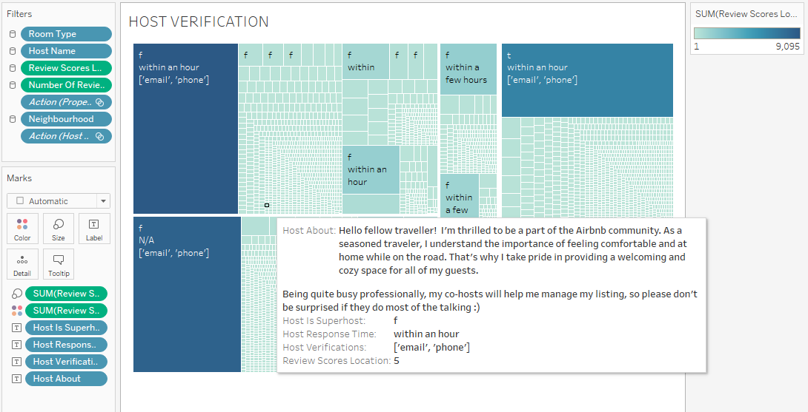
Evaluate host characteristics, including super host status, response times, and verification methods.
Host Performance:
Distributing Host About, Host is Super host, Host Response Time, Host Verification, Review Scores Location

Slide 13
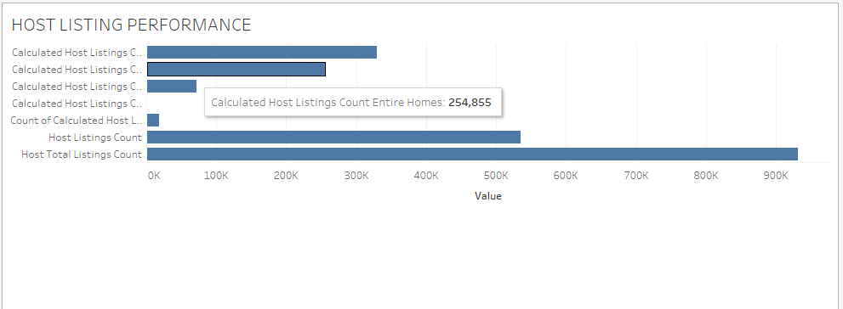
Explore correlations between host attributes and listing performance.
Host Performance:
Correlation between host attributes and listing performance in differ Property type.

Slide 14
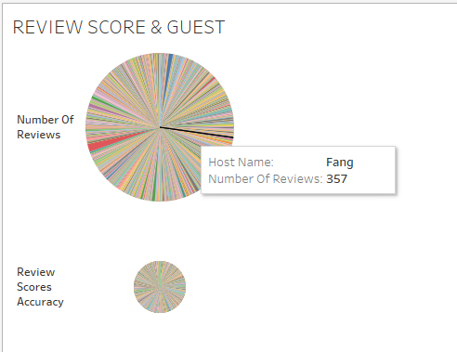
Examine review scores and their impact on overall listing performance.
Review Scores and Guest Satisfaction:
Finding Host Name with Number of reviews and Score Accuracy

Slide 15
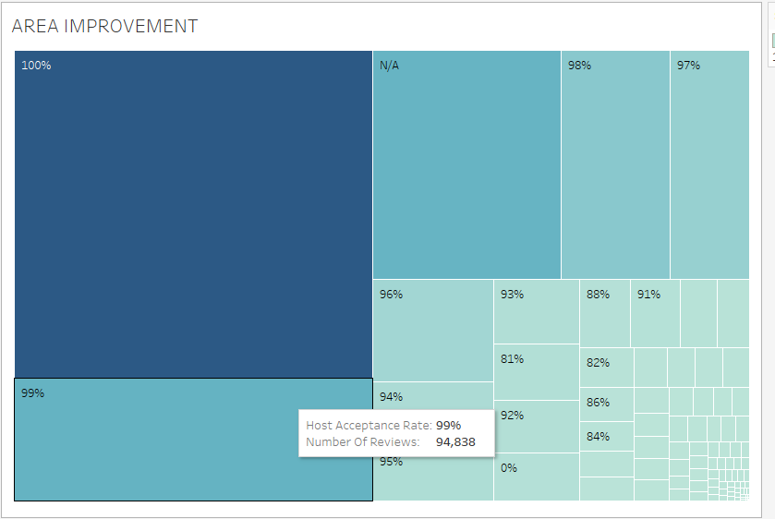
Identify areas for improvement based on specific review categories.
Review Scores and Guest Satisfaction:
Host Acceptance rate with number of reviews

Slide 16
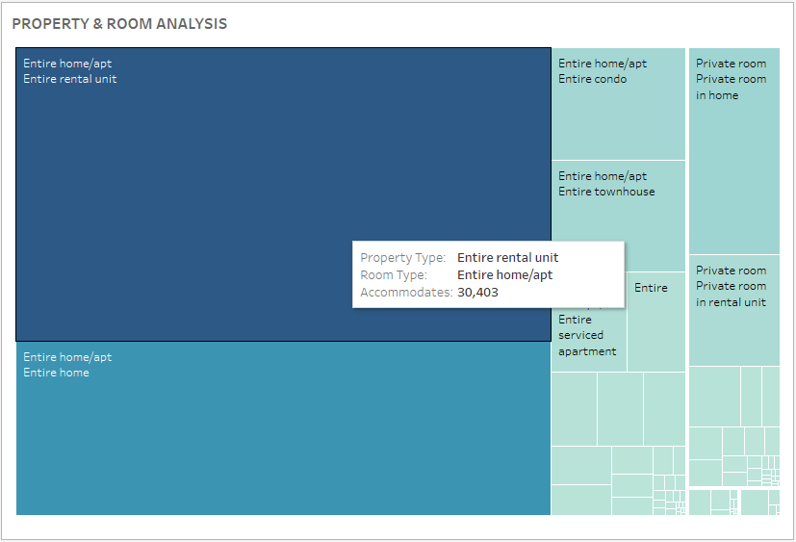
Analyze the distribution of property types and room types.
Property Type and Room Analysis:
Property type, Room Type, and Accommodations

Slide 17
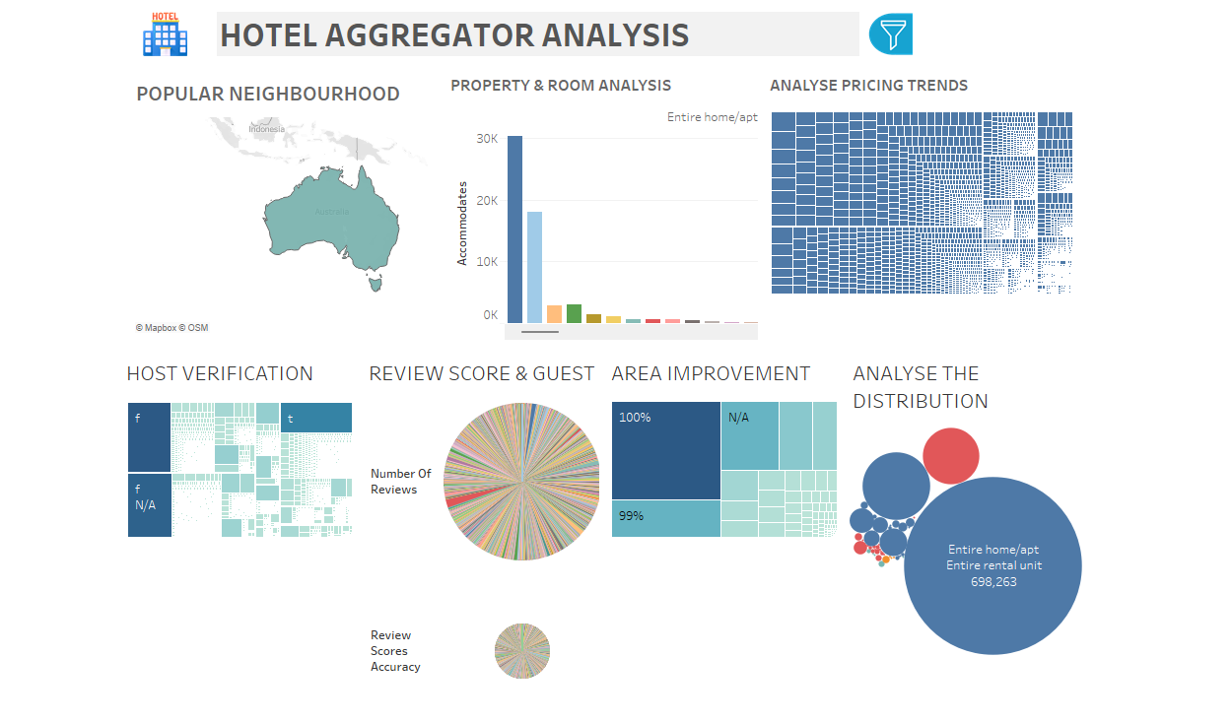
DASHBOARD 1
A Dashboard showing the information on different areas of insight

Slide 18
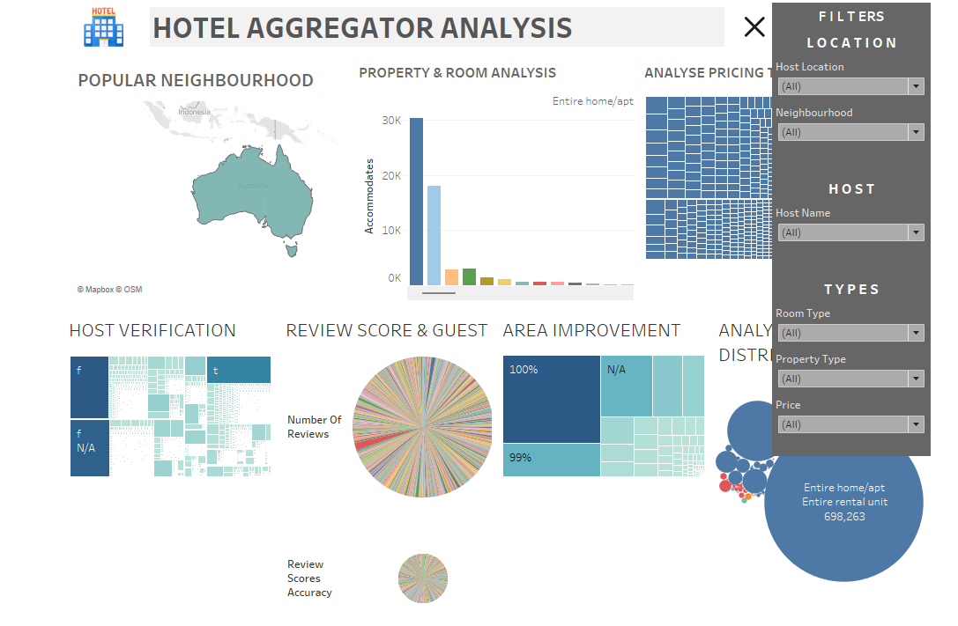
DASHBOARD 2
A Dashboard showing the filter options

Slide 19
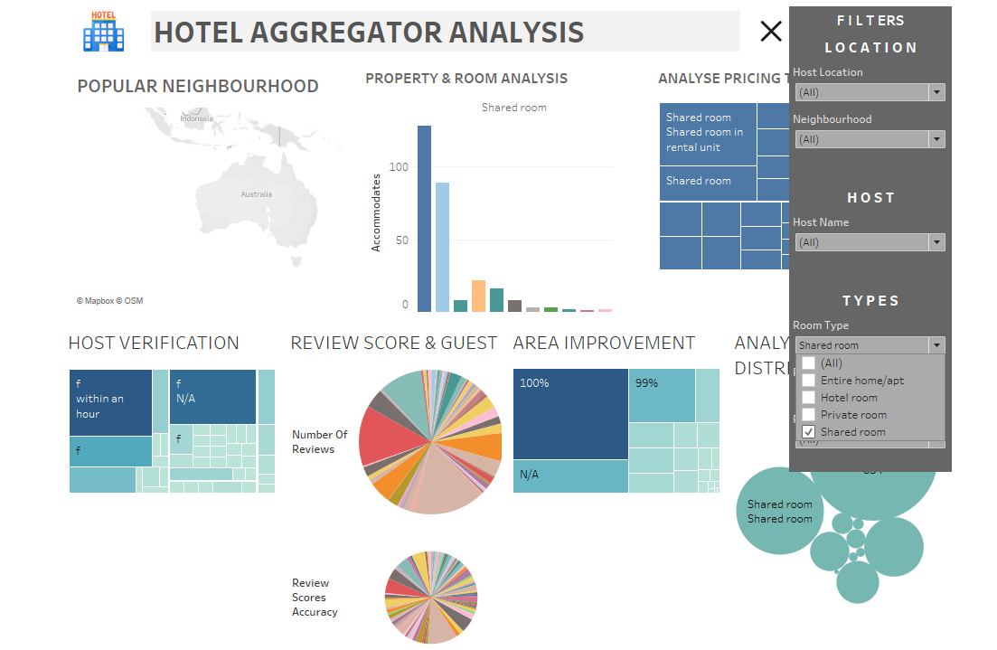
DASHBOARD 3
A change in the dashboard when the filter is used

Slide 20


Deliverables
- Interactive Power BI/Tableau dashboards illustrating geographical distribution, pricing trends, host characteristics, and review scores.
Reports on availability patterns, property, room preferences, and factors influencing guest satisfaction.
Recommendations for hosts and the aggregator platform based on the analysis.

Slide 21


Project Insight
Understanding the data is the most important factor before starting analyzing
Cleaning and checking the null values.
Understanding geographic role.
Representation and fact of the type of data.
Checking the values of data before creating charts and visuals.
Understanding the basic needs of different charts.
Formatting the graph chart to make it more user-friendly.
Applying filters for more interactive dashboard.

Slide 22


Conclusion
This project provides interns with hands-on experience in leveraging Power BI/Tableau for meaningful analysis and insights generation in the competitive domain of hotel aggregator listings.

